Slide 1

Mini-Project
Abel Lagonell
Jaleel Rogers

Slide 2



Agenda
Objective
The Program
Algorithm Design
Experiment Design
Q&A
Works Cited

Slide 3
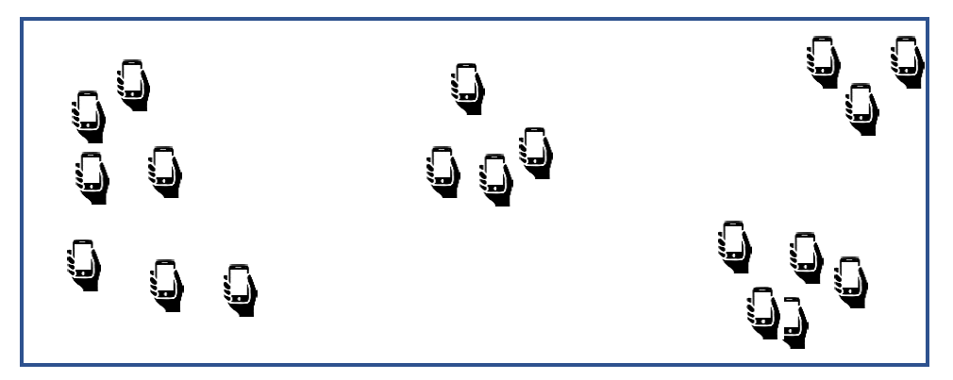
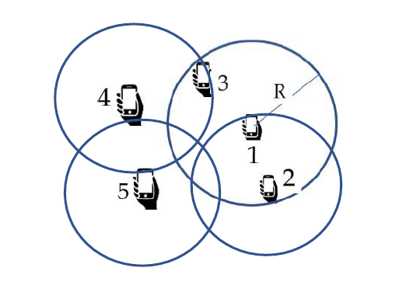
Objective
Sketch and Collect Data to all citizens of Lakeland owning a smartphone in the form of:
GPS locations (uniform, distributed, and clustered)
Maximize coverage at minimum cost
Contrast Acquisition Models
Random Acquisition, Pure Greedy, and Greedy Set Cover

Slide 4

The Program

Slide 5


Used Python for the project
Has built-in graphing features
More readable
For graphing we used Plotly
Creates interactive and visually appealing graphs i.e., built-in zoom, autoscaling, etc.
Program consists of Two skeleton classes, Node and Grid.
Program also has four other classes dealing with representation of the model.

Slide 6

Algorithm Design

Slide 7
Thought Process
Turn On Brain
First but most important step, can’t think without it
Research Algorithms
Over four algorithms to choose from; knapsack, minimum spanning tree, set cover, and budgeted maximum coverage
Write Down Steps
Easy to understand and structure the algorithm to understand the objective of the algorithm and result
Turn to Pseudocode
Implement in Code
Visualize it
Makes for a clearer perspective

Slide 8
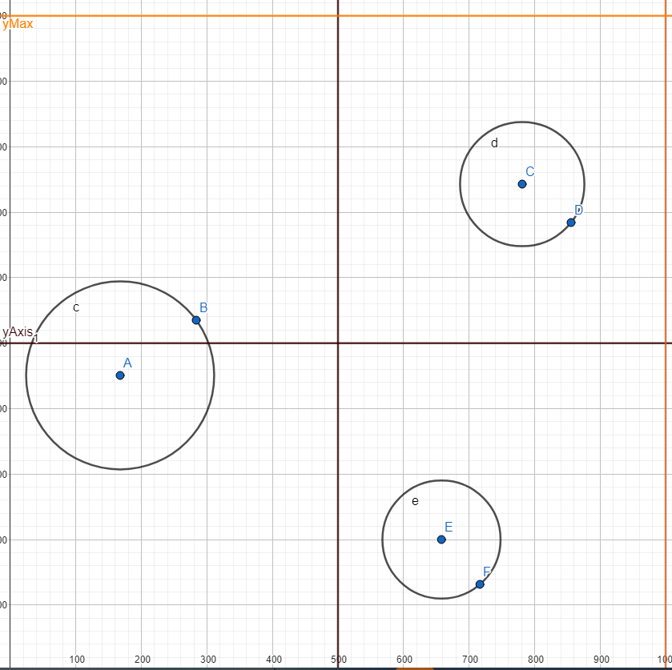
THE PRICE RANGES
The Different places where the costs are different. A – Poor (0.1-0.5) C – Middle (2-5) E – High (5-7) DEFAULT – (1-2)

Slide 9
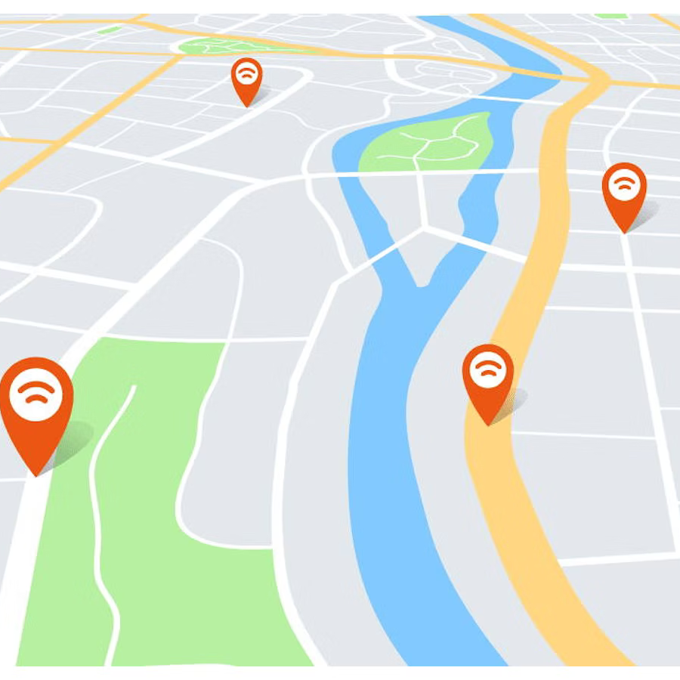
Why Greedy Set Cover Algorithm
Time Complexity is O(mn) at best
Efficient than Set Cover Algorithm
Used in real-life scenarios
Allocation of equipment
Location of buildings meeting demand in an area
Telecommunications covering minimum stations for users

Slide 10
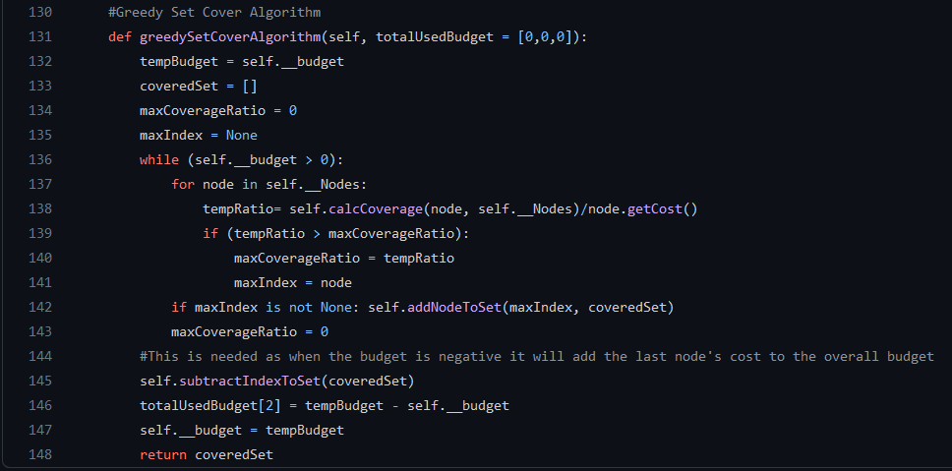
Greedy Set Cover Algorithm
Enters a loop until budget is exhausted
Finds node with highest coverage ratio
Once found it will be added to the coveredSet
Greedy because each step chooses node with highest coverage ratio
Notes:
~Universe covers all elements, uncoveredSet covers elements that haven’t been covered and coveredSet covers the elements that will be included
~Coverage ratio is calculated as ration of the number of uncovered elements covered by the node to its cost
~Algorithm is focused on short-term

Slide 11

Experiment

Slide 12
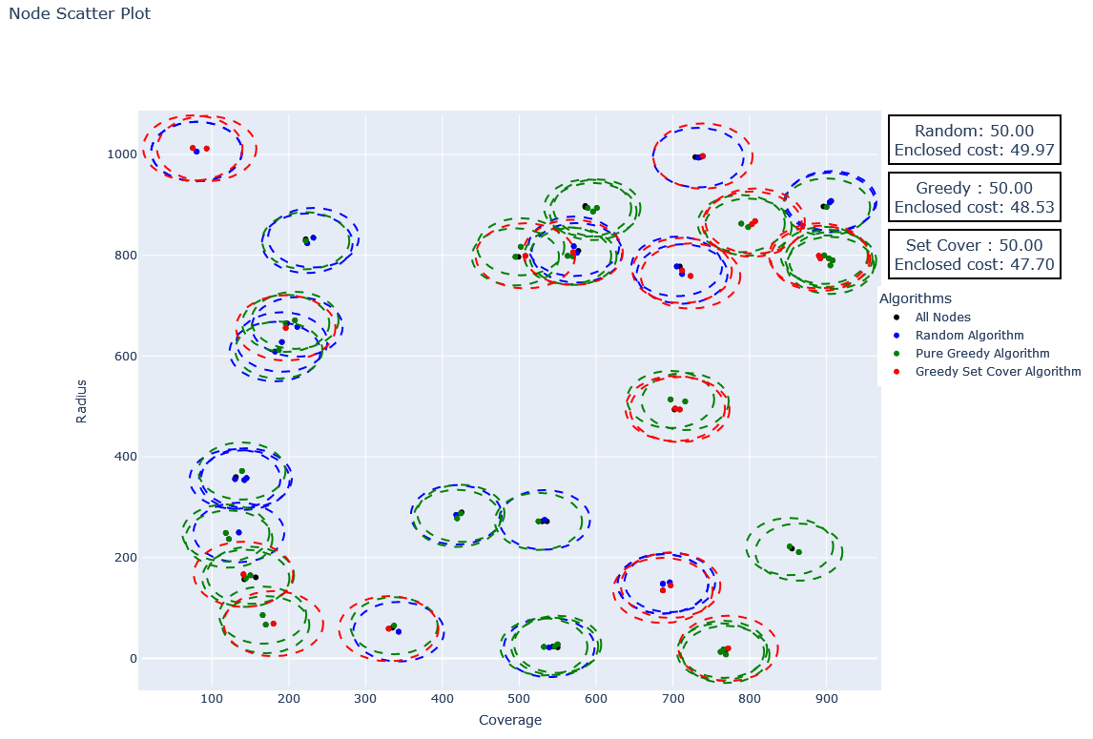
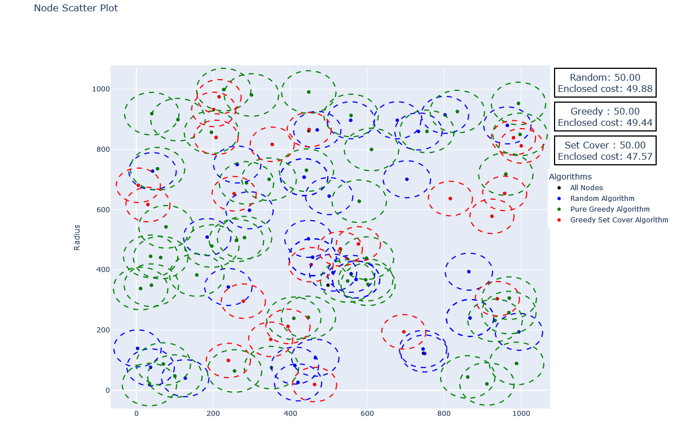
Acquisition Model
Contains all three algorithms on one graph
Amount of coverage areas vary per algorithm
Greedy Set Cover & Pure Greedy mostly chose lower value nodes
Fig.1 Radius Vs. Coverage (Clustered Mode)
Fig.2 Radius Vs. Coverage (Uniform Mode)
Notes:
The Random algorithm selects nodes randomly, while the Pure Greedy algorithm selects the nodes with the lowest cost. The Greedy Set Cover algorithm selects nodes based on their coverage and cost ratio.

Slide 13
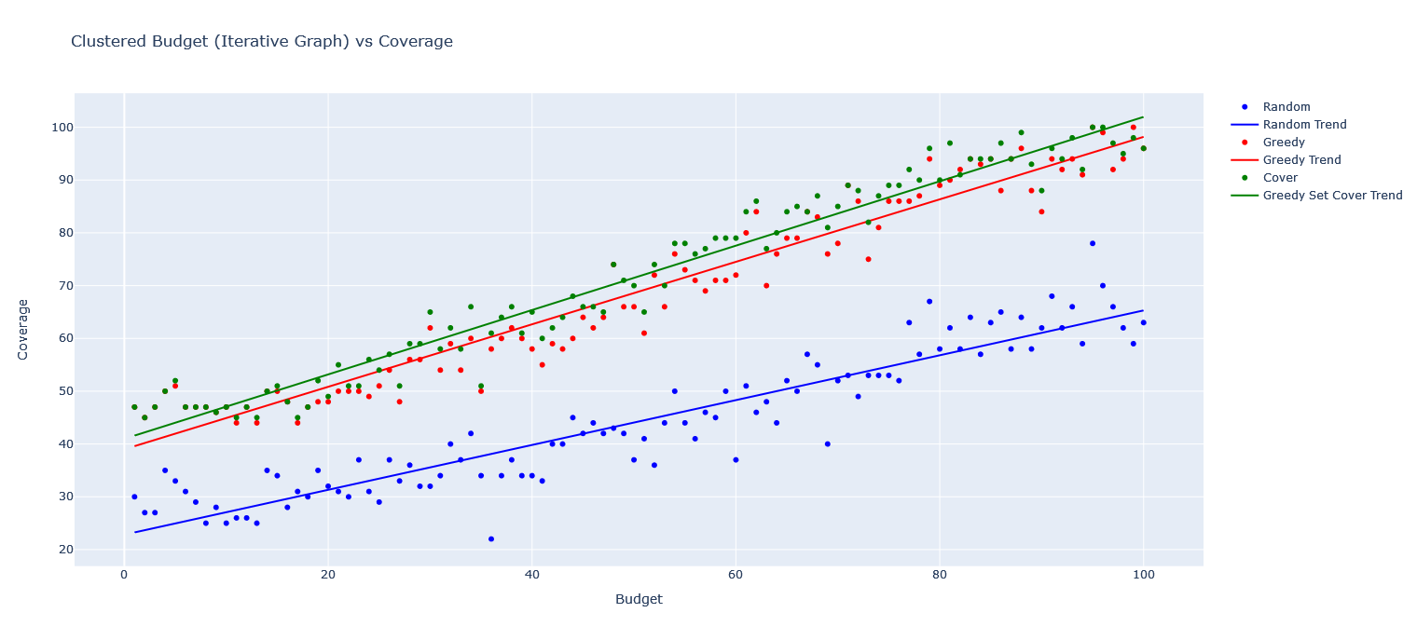
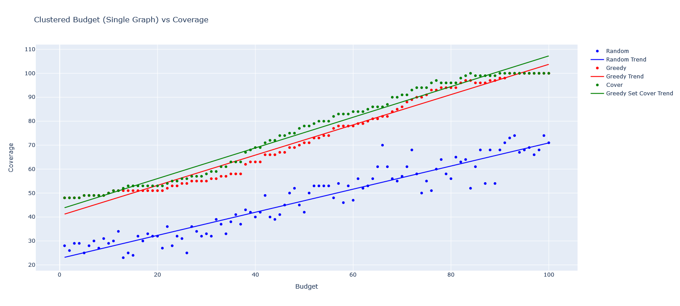
Clustered Budget Vs. Coverage
Greedy & Greedy Set Cover perform similar in both multiple tests & single
Positive correlation between Coverage & Budget
Random is not as effective as Greedy Set Cover & Pure Greedy

Slide 14
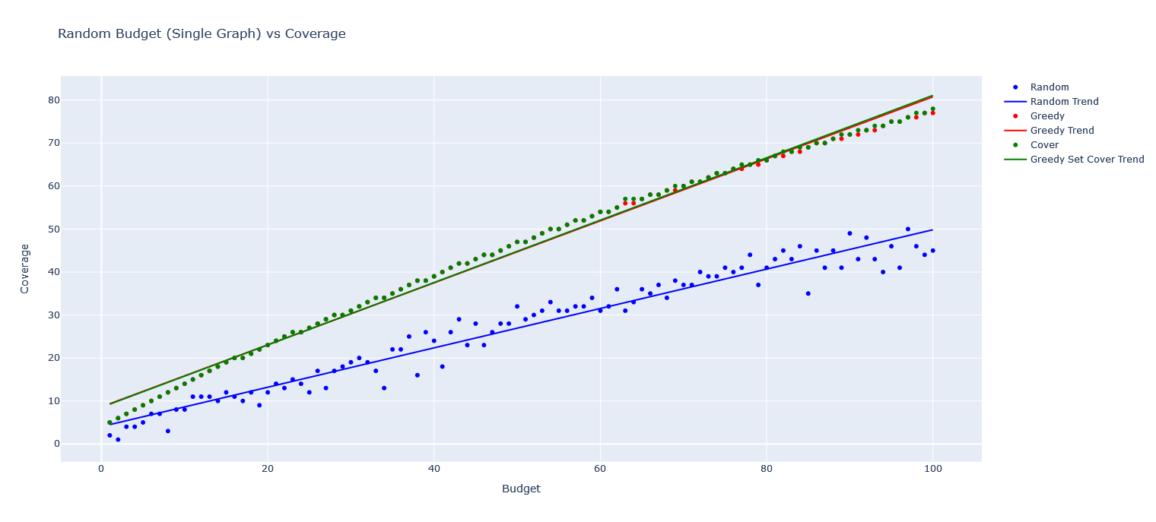
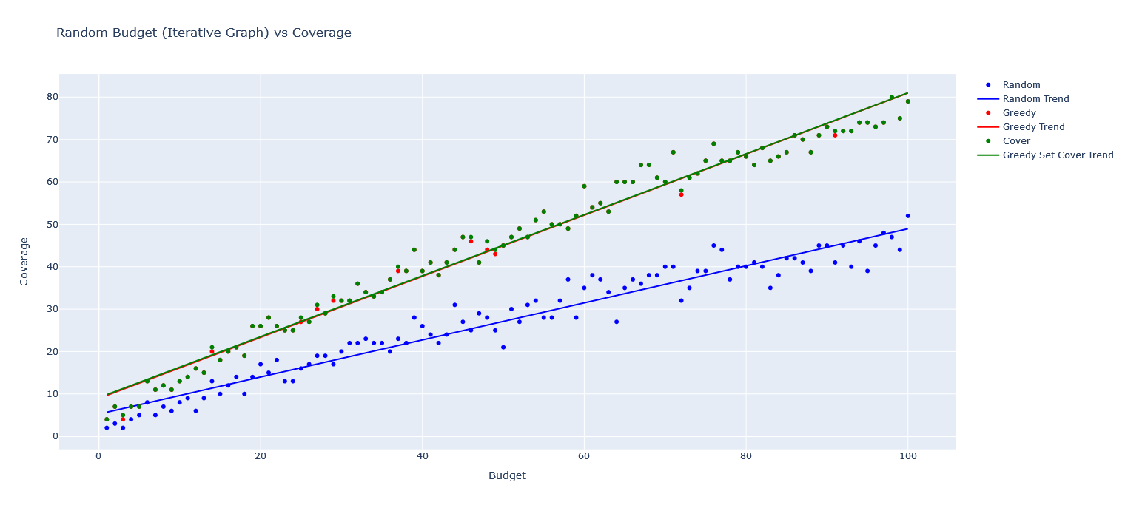
Random Budget Vs. Coverage
Pure Greedy & Greedy Set Cover have nearly the same performance
Positive correlation between Rang Budget & Coverage
Random is still less effective than the other algorithms

Slide 15
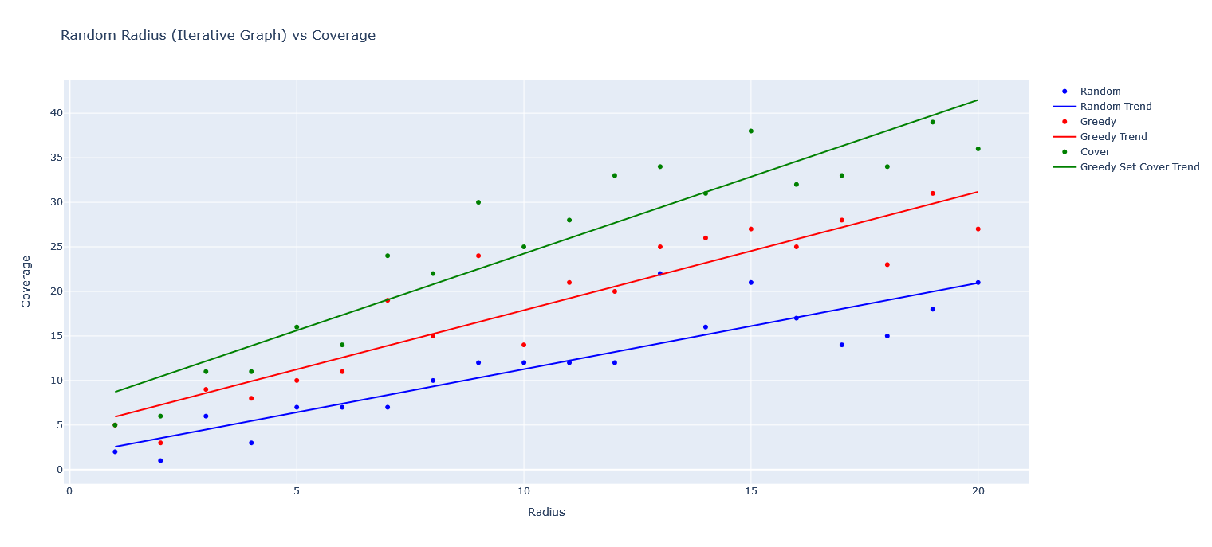
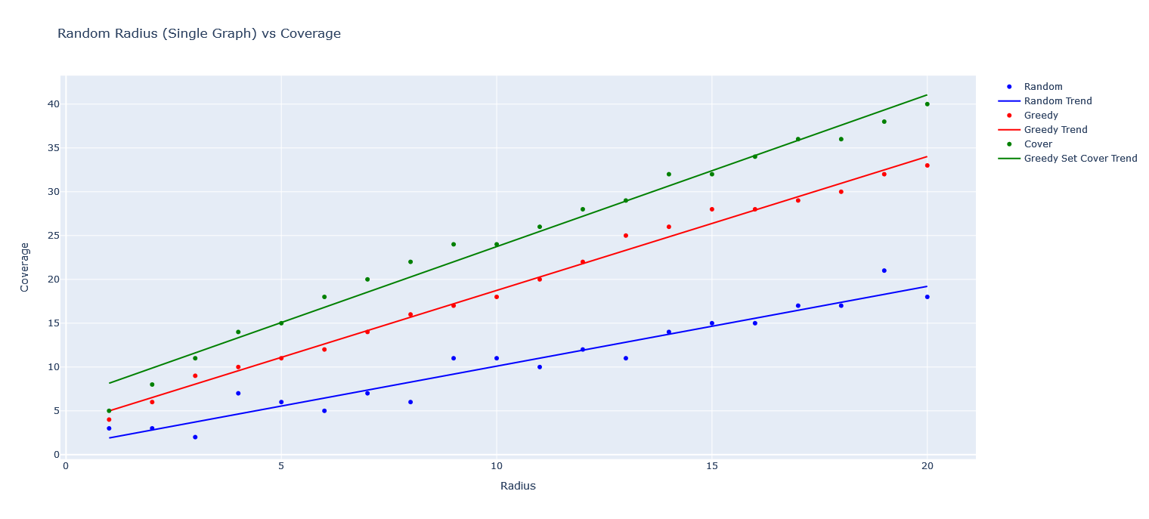
Random Radius Vs. Coverage
Points are significantly spaced out
Algorithms’ performance is not consistence across all inputs
Trendline of Random is closer to the others
Positive correlation between Random Radius & Coverage

Slide 16
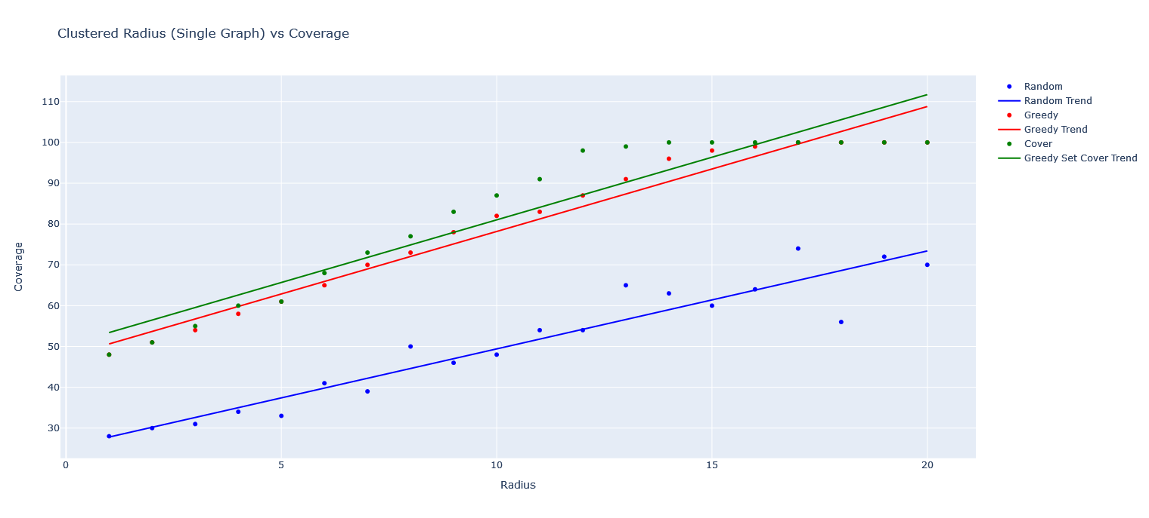
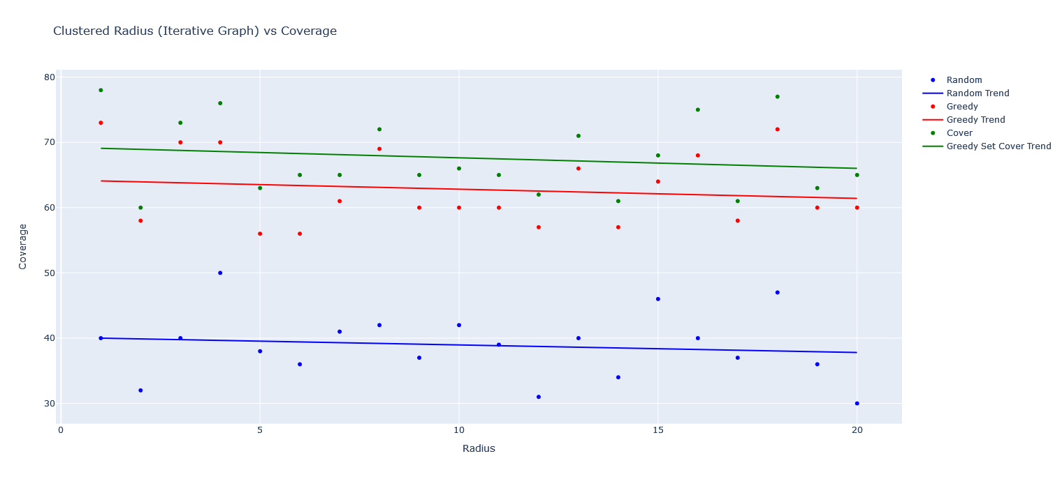
Clustered Radius Vs. Coverage
Points are significantly spaced out
Algorithms’ performance is varies per graph
Positive correlation between Random Radius & Coverage on Single
No correlation on Iterative

Slide 17
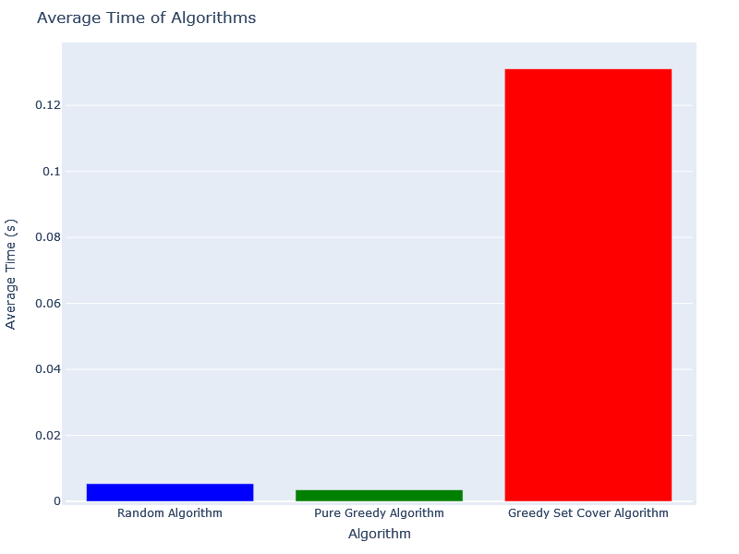
Time Complexity of The Algorithms
Average of algorithms running 10 times with 100 randomized nodes
Processing varies based on computer’s hardware
Consistently Greedy Set Cover take significantly longer
Pure Greedy – O(n)
Random – O(n)
Greedy Set Cover – O(n^2)

Slide 18
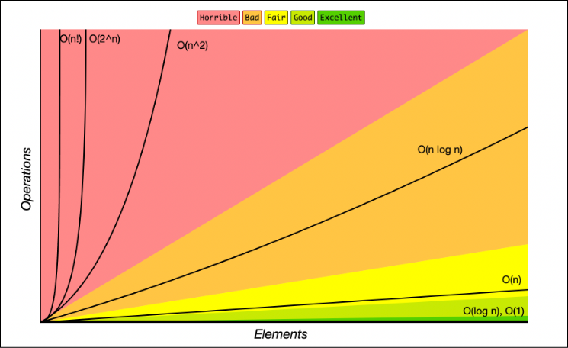

Slide 19


Thank You
Any questions

Slide 20
Works Cited
Plotly (library) - https://plotly.com/python/
Time (library) - https://docs.python.org/3/library/time.html
Numpy (library) - https://numpy.org/
Github - https://github.com/Abel-Lagonell/Alg_Design/tree/main/MiniProject%201

